Slide 1

CLASSIFICATION OF SIGNIFICANT WATER RESOURCES AND DETERMINATION OF RESOURCE QUALITY OBJECTIVES FOR WATER RESOURCES IN THE USUTU TO MHLATHUZE CATCHMENTS (WP11387)
8.7 WATER RESOURCE CLASS DECISION SUPPORT SYSTEM

Slide 2
Water Resource Class Decision Support System
(WRC-DSS)
Andrew Birkhead

Slide 3
BACKGROUND TO THE WRC-DSS
The Water Resource Class Decision Support System (WRC-DSS) has been developed & refined over time, largely by WRP (late Pieter van Rooyen).
WRC-DSS incorporated four linked excel files and ~30 worksheets
A refined DSS contains:
single MS excel file running macros for calculations (VBA) rather than cell-based formulae;
this makes it modular for easier set-up and data population for a range of catchment configurations that include any number of Resource Units (RUs) within delineated Units of Analysis (IUA);
it is simple to use: only two main data input & results worksheets

Slide 4
PURPOSES OF THE WRC-DSS
Two primary purposes:
1. Calculate Water Resource Class (I to III) for each IUA, which are defined by the ‘distribution of Ecological Categories (A to F) assigned to RUs in an IUA’ - termed the Catchment configuration
Classes are determined for various scenarios: PES, REC, operational scenarios, etc.
Scenario numbering not strictly followed, as definition of scenarios changes between rivers and estuaries.

Slide 5
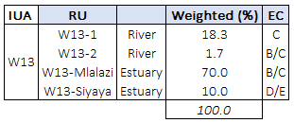


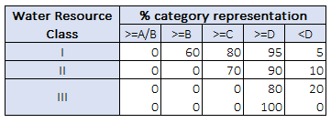


COMPUTING THE WATER RESOURCE CLASS (FOR A SCENARIO)
Forestry
Catchment configuration
Protected area
B
A/B
Streamflow reduction
Rural
B
Irrigation
Rating rules:
C
D
Dams
D
Return flows
Urban
E
Industry
C/D
Water Resource Class II
EWR site
Estuary

Slide 6
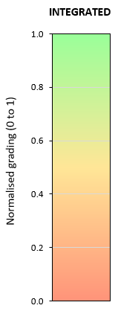
PURPOSES OF THE WRC-DSS
2. Apply Multi-Criteria Analysis (MCA) techniques to give an integrated assessment of scenario consequences from four components:
Best = 1
Ecology
Ecosystem Services
Economic:
Economic indicator (e.g. GDP)
Employment
An integrated grading (or ranking) from best (1) to worst (0) provides the balance between these four components
Worst = 0

Slide 7
MULTI-CRITERIA ANALYSIS
MCA is appropriate for comparing alternatives when the consequences, or outcomes, are expressed using different variables:
Weightings can be changed (per IUA)
Ecological consequences: scored according to the degree that the REC is met, with the REC set to 100%.
Ecosystem Services: scored relative to the present state or Baseline, with the Baseline set to 1.0.
Economic indicator assesses change in monetary terms, i.e. GDP - relative to Baseline set to 1.0.
Employment assesses the change in job opportunities from Baseline set to 1.0.
50% ecology
50% socio-economic
The integrated grading of scenarios allows for weighting scores from these four components, and two methods of ranking, viz:
rank order (with average);
normalised score (recommended for use)

Slide 8
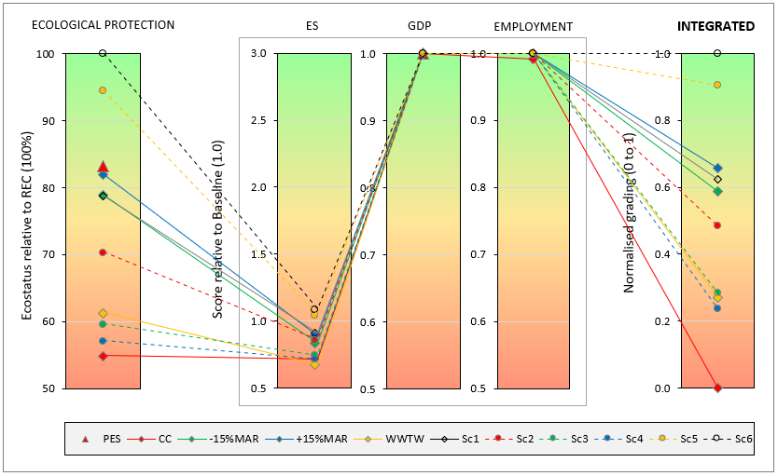
MULTI-CRITERIA ANALYSIS
Graphical output from the MCA for IUA W13 using ‘traffic plots’, which display the graded scenarios per component and as an integrated normalised score (0 to 1)
Changing weightings may change score

Slide 9
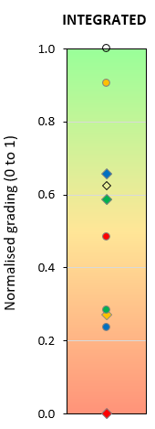
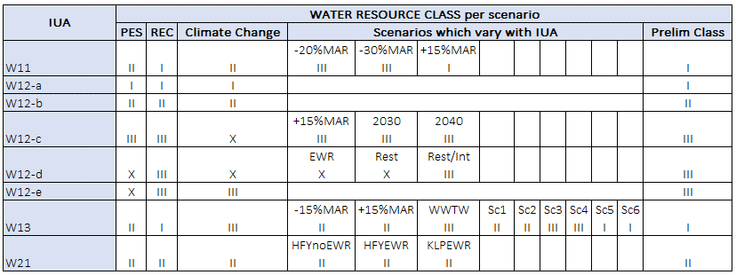
WRC-DSS
Based on the integrated gradings for the scenarios and the WRCs, the WRC-DSS is used to inform Target Ecological Categories (TECs) for the relevant RU, and hence the Water Resource Class for the IUA.
+

Slide 10
DEMONSTRATION OF WRC-DSS

